Slide 1
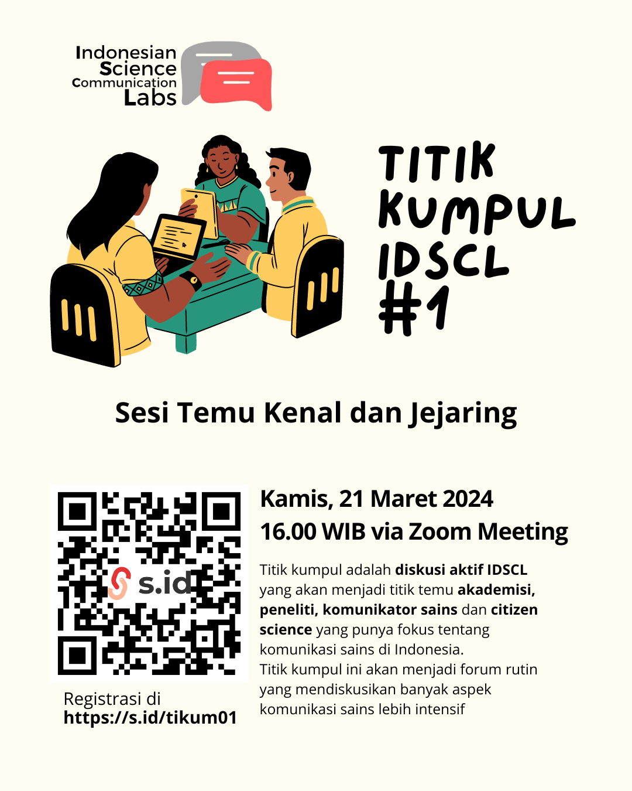
Kamis,
21 Maret 2024

Slide 2
Agenda Kita Sore Ini…
TL;DR IDSCL
⁠⁠Perkenalan
Breakout Room (~15 menit)
⁠⁠Sharing
⁠⁠Wrap Up
TL;DR Too Long; Didn't Read.

Slide 3
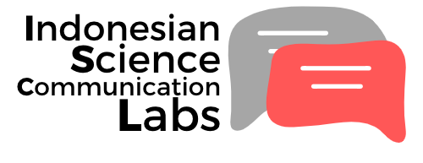
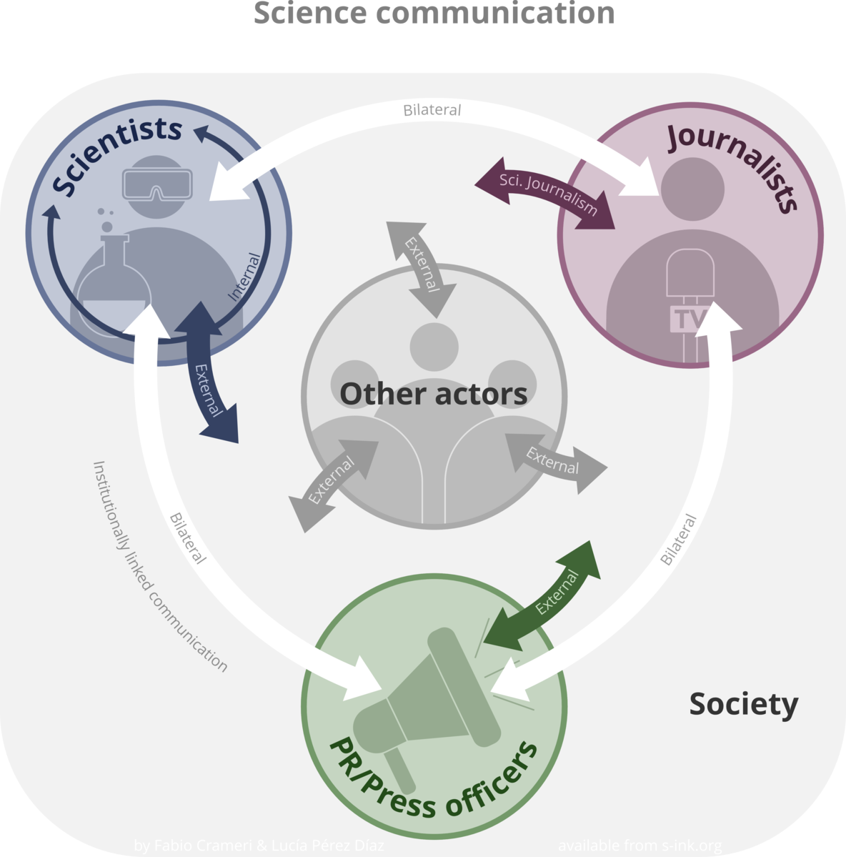
TL;DR
Framework:
Laboratorium komunikasi sains untuk penelitian, pengembangan, pelibatan, dan penjangkauan masyarakat dengan pendekatan inter-disiplin di Indonesia.
Kata Kunci:
Keterlibatan publik;
Kolaboratif;
Dialog;
Inklusif
Public engagement;
Collaborative;
Dialogue;
Inclusive
https://idscl.id/
Könneker, C. (2020). Wissenschaftskommunikation und Social Media: Neue Akteure, Polarisierung und Vertrauen. In J. Schnurr & A. Mäder (Eds.), Wissenschaft und Gesellschaft: Ein vertrauensvoller Dialog: Positionen und Perspektiven der Wissenschaftskommunikation heute (pp. 25–47). Springer. https://doi.org/10.1007/978-3-662-59466-7_3
Image: Fabio Crameri and Lucía Pérez Díaz – s-ink.org online science graphics collection · Source site: https://s-ink.org/science-communication CC BY-SA 4.0

Slide 4
Research disciplines influencing science communication
Natural
Sciences
(Science) Education Sciences
Science
Communication
Social Science
(Studies of science and technology)
Communication
Sciences
Mulder, H. A. J., Longnecker, N., & Davis, L. S. (2008). The State of Science Communication Programs at Universities Around the World. Science Communication, 30(2), 277-287. https://doi.org/10.1177/1075547008324878

Slide 5
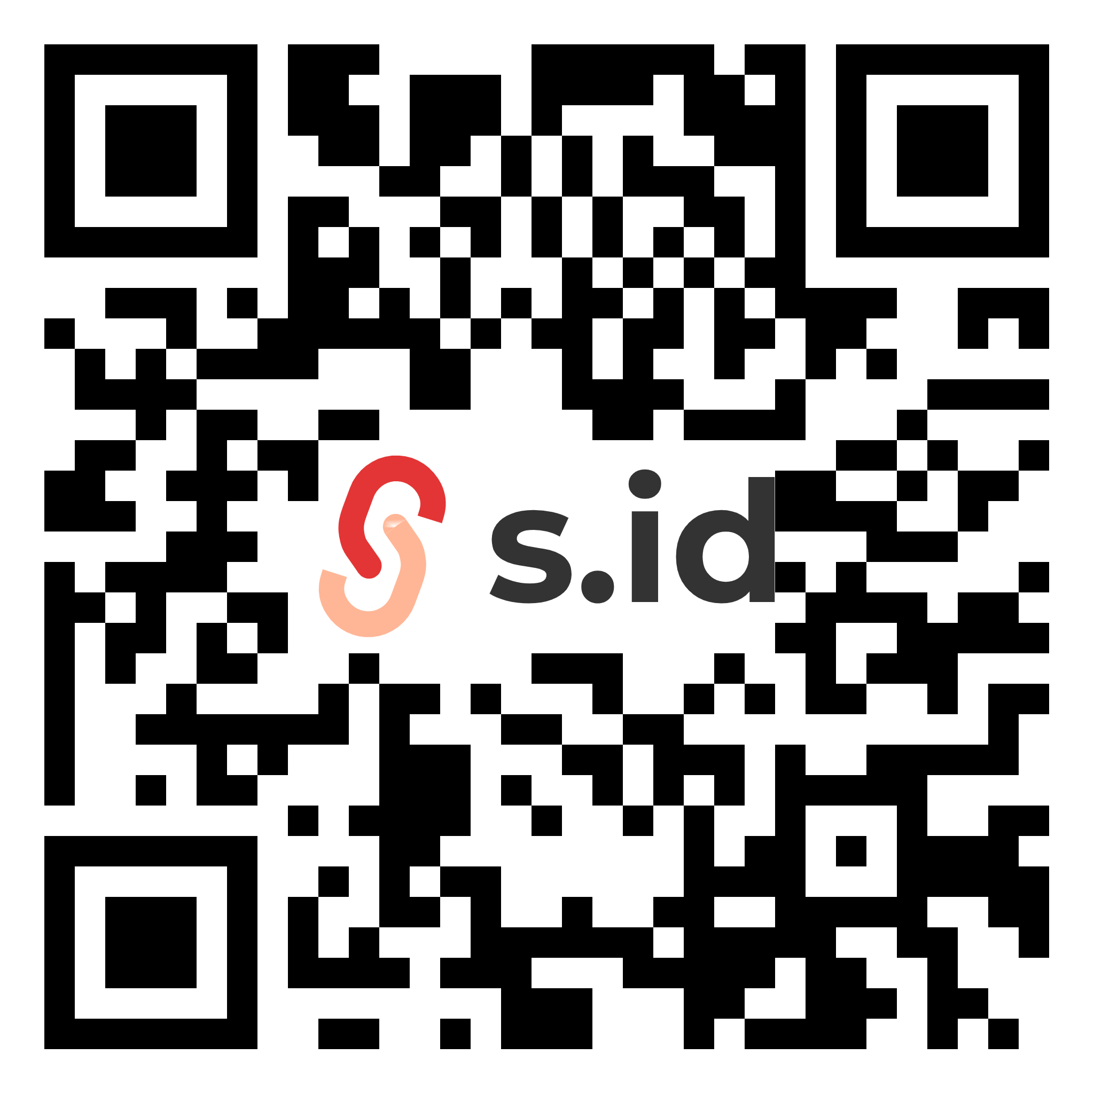
Perkenalan
https://s.id/jejaring-idscl

Slide 6
Breakout Session
(‘15)

Slide 7
Sharing

Slide 8
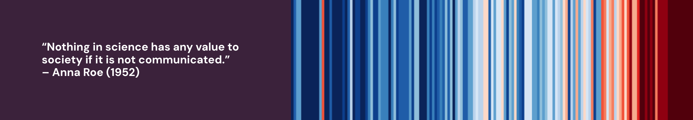
Wrap Up

Slide 9
https://s.id/jejaring-idscl

